Slide 1
Team : ERROR FOUND
Team members:-
Vaibhav Sharma
Neha Saini
Kamad sharma

Slide 2
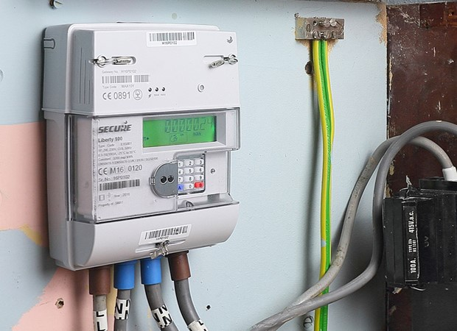
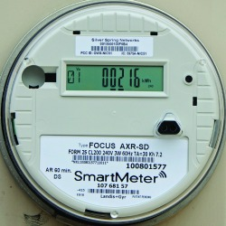
SMART METER

Slide 3
Presentation Outlines
Introduction
Smart Meter
What in our App?
Advantages of our App

Slide 4
Introduction
The present system of energy metering as well as billing in India uses electromechanical and somewhere digital energy meter.
It consumes more time and labour.
One of the prime reasons in the traditional billing system which is inaccurate.
Many times slow, costly, and lack in flexibility as well as reliability.
Today accuracy in electricity billing is highly recommended.
The smart energy meter gives real power consumption as well as accurate billing.
It provides real time monitoring of electricity uses.
It is less time consuming and cost effective.

Slide 5
Smart Meter
A smart meter is an electronic device that records consumption of electric energy and communicates the information to the electricity supplier for monitoring and billing. Smart meters typically record energy hourly or more frequently, and report at least daily.
# What is the Idea?
Balancing Demand and Supply
Supply of the electricity depends on the demand of the consumption on daily bases.
Stability and Safety
Use of the Reneweable

Slide 6
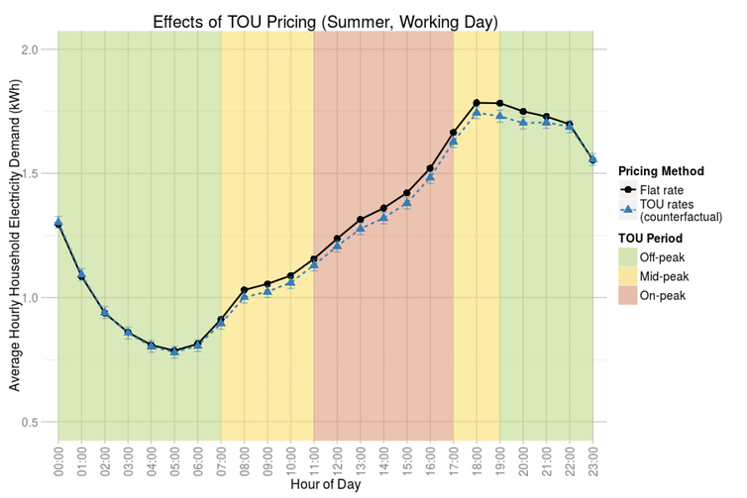

Slide 7
#How does it work ?
Sensors Everywhere – Sensors depends on the temperature as well as humidity . Whenever temperature or humidity high electricity consumption is more otherwise less.
Wireless Communication – Data is sent by wireless because it is less expensive.
#Disadvantage:
Vulnerable to cyber attack
Supper Expensive
Not a solution just management

Slide 8
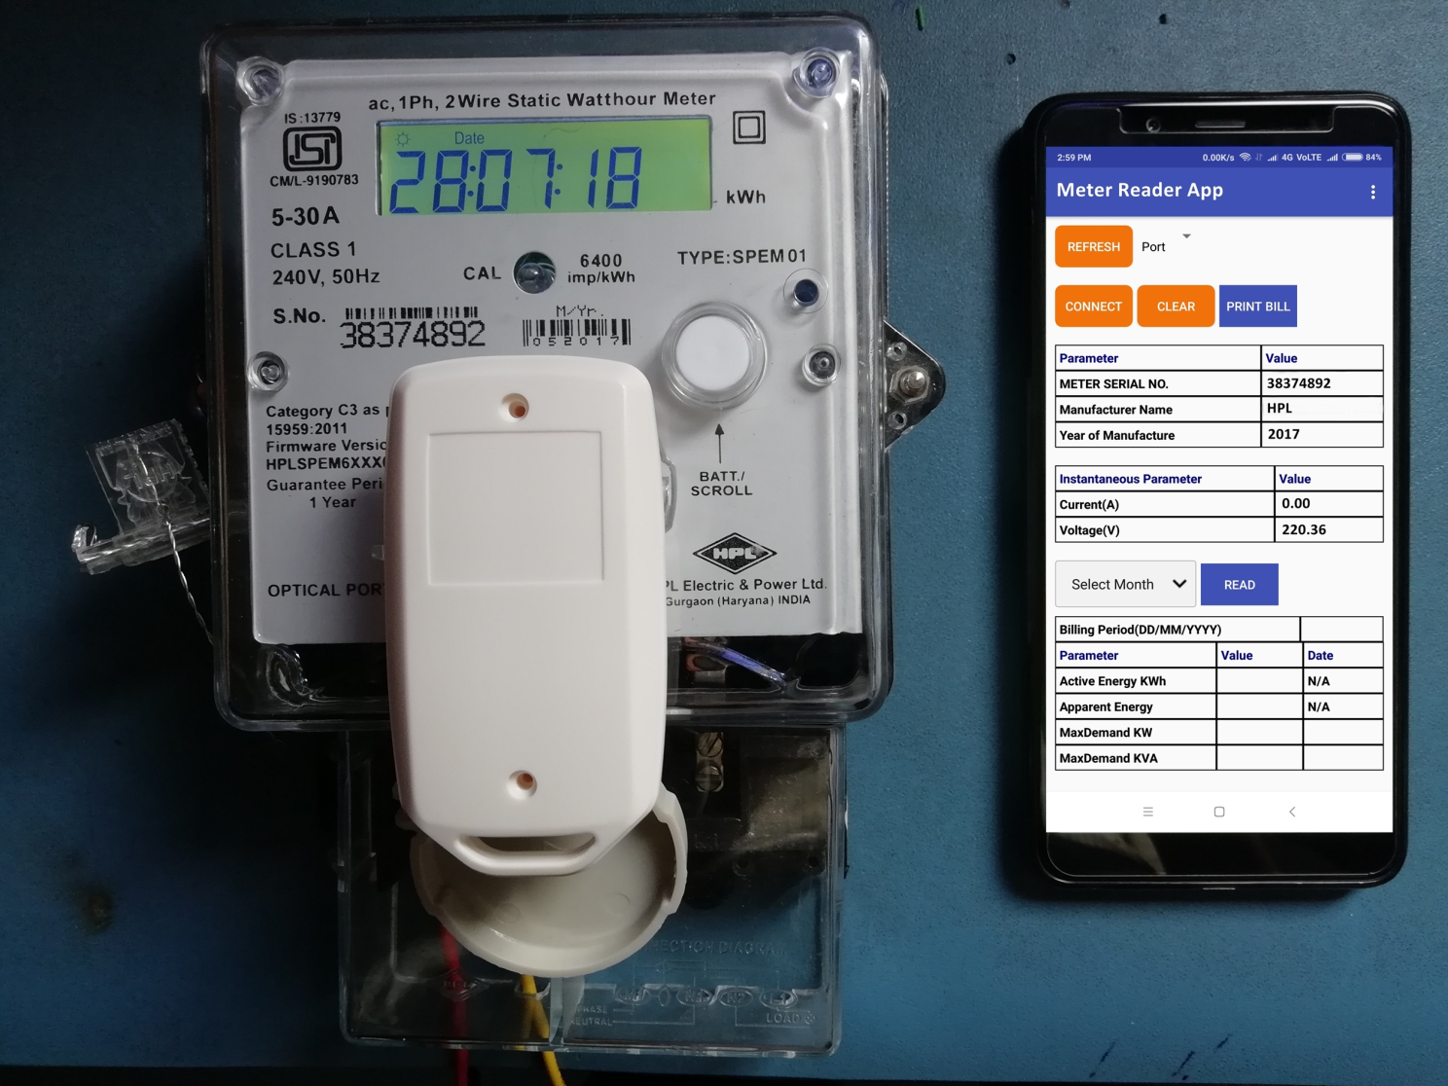
What In Our App ?

Slide 9
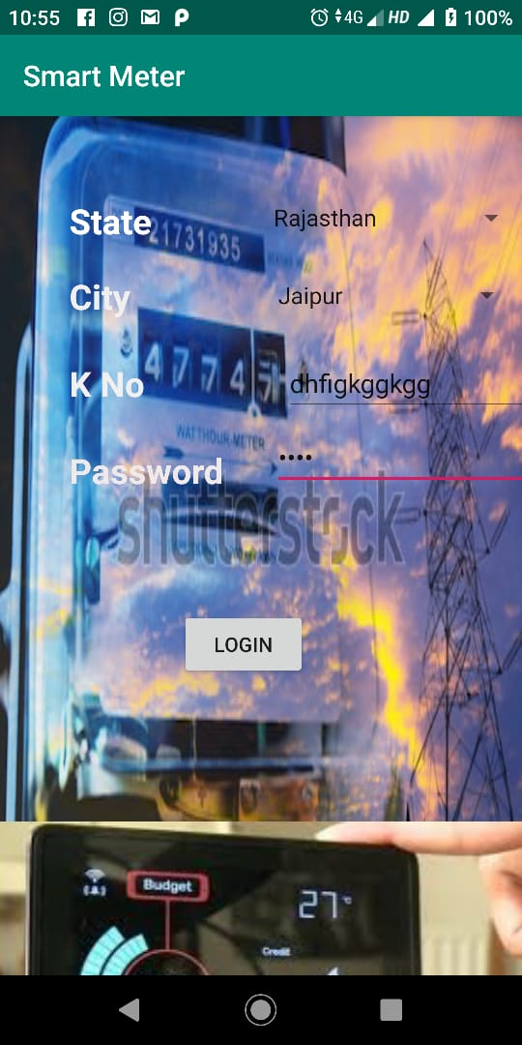
Login:
This is the first step to access this app. User cannot access this app without 11 digits of K No. and 10 digits Password. Every electricity consumer providers provides K No. as well as password .

Slide 10
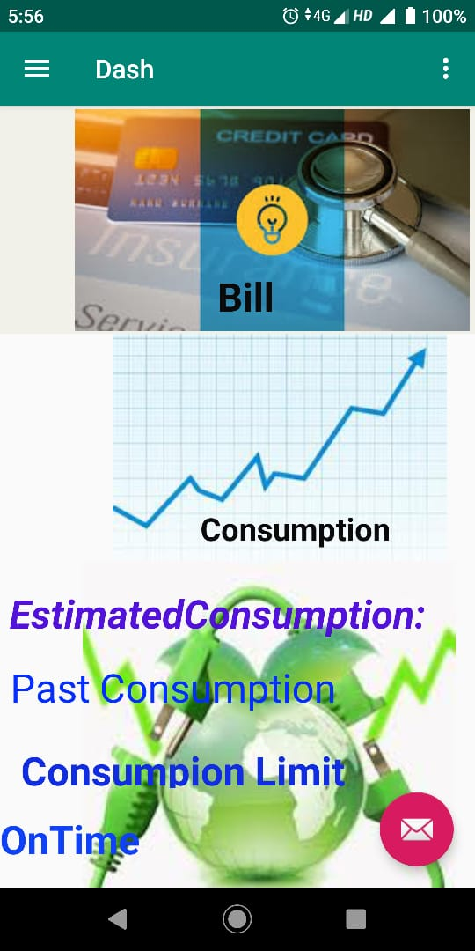
Dashboard:
Login by user dashboard page will display. In this user have three options of paying direct bill, or see there consumption and see the After current bill reading in there app itself which makes it befit for user itself ,or set the limit of consumption and see the present consumption if consumption goes high user get notification.

Slide 11
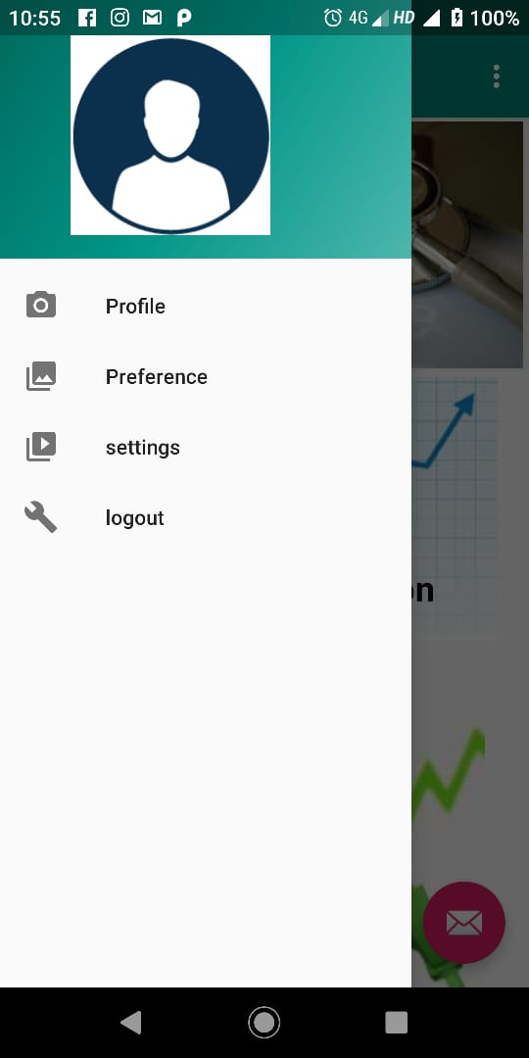
Dashboard:
In the side view or navigation view user can access there profile or edit them in settings which will be connected to cloud.
The Profile option makes is easy for consumer to maintain there information and update if necessary according to norms .
This makes it consumer friendly and also have benefit to discom itself as they we get info update immediately
User can logout there profile if they want.

Slide 12
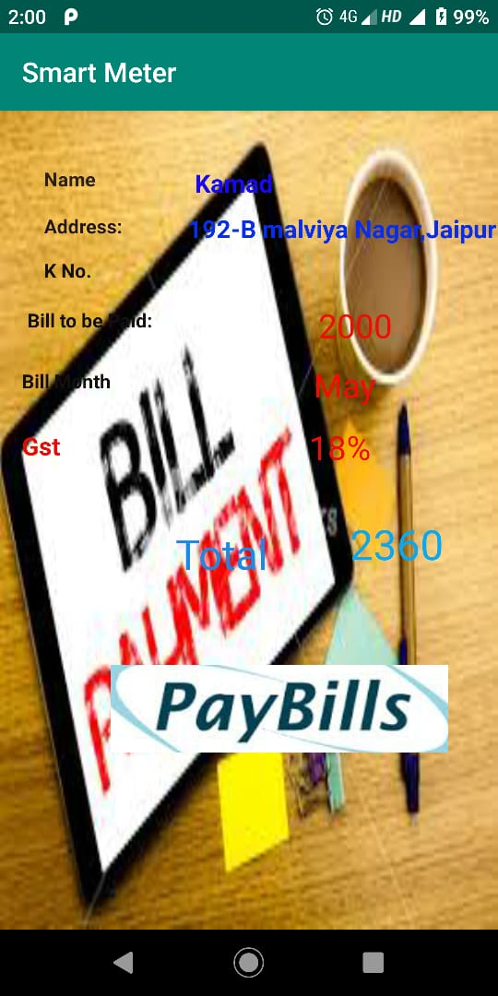
Bill:
It provides the secure platform for consumer to pay online bills and also can predict estimated bill of the month.
It also notify the consumer before the last day.

Slide 13
ADVANTAGES OF OUR APP
In case if electricity is cut by the provider then to again consume the electricity user has to pay the previous pending bills and penalty and after that the consumer start consuming electricity. This feature is good for user and provider , it reduce the cost as well as men power.
It is user friendly app , as user not able to understand the direct reading of the smart meter this app provide the user to understand the meter and how much it consume.
This app provide one feature in which we can set limit whatever user want according to the pervious consumption so that user can manage our present consumption and give alert message if user cross the limit.
If user has low salary then this provider gives some schema to the user so that user as well as provider get profit in that.

Slide 14
THANK YOU

